Slide 1
Text to image generation

Slide 2
Introduction
Text to image generation is a machine learning task in which a system is trained to generate an image based on a textual description or prompt.
The system takes in a textual description, such as a sentence or paragraph, and produces a corresponding image that captures the visual content described in the text.
The goal is to produce images that are semantically and visually consistent with the given text, which requires a deep understanding of both language and visual concepts.

Slide 3
Problem statement
To develop a model that can generate a visually plausible image from a given textual description.
The model needs to learn the mapping between language and visual representations and generate an image that is semantically and visually consistent with the given text.
The challenge lies in the fact that the model needs to handle the abstract concepts and relationships expressed in text, and map them to a diverse set of visual representations.

Slide 4
Motivation
To allow the creation of synthetic images from textual description
Useful in a variety of applications, such as computer vision, art, education and entertainment
To bridge the gap between natural language and visual representation
Additionally, can generate diverse and representative datasets for training and testing other AI models

Slide 5
Abstract
Generating images from textual descriptions is a challenging task in the field of computer vision and artificial intelligence In this paper we propose a deep learning-based approach for text-to-image generation using Generative Adversarial Networks (GANs).
To accurately generate images based on the input text. The model will take a textual description as input and generate an image that resembles the description.
Our model consists of two components: a generator network that generates images from textual descriptions and a discriminator network that evaluates the generated images.
The performance of the model will be evaluated using various metrics, including image quality, semantic consistency, and overall image fidelity.

Slide 6
Literature survey
A machine learning job called "text to picture generation" trains a system to create an image from a textual description or prompt. The system receives a textual description, such as a sentence or paragraph, and generates an image that accurately represents the visual information specified in the text. We acquire visuals from the pre-described text description, in which sometimes the contextual understanding & semantic consistency is bit of a challenge. However, if we can close this gap, text to image generation can be a very useful tool.

Slide 7
Author | Title | Summary
Z. Wang, Z. Quan, Z. -J. Wang, X. Hu and Y. Chen, 2020 IEEE International Conference on Multimedia and Expo (ICME), 2020, pp. 1-6, doi: 10.1109/ICME46284.20 20.9102904. | "Text to Image Synthesis With Bidirectional Generative Adversarial Network," | This paper proposes a semantics enhanced attention module and a semantics-enhanced batch normalization module that improve consistency of synthesized images by involving sematic features precisely.
Zhuoyao Zhong; Lianwen Jin; Shuangping Huang Date of Conference: 05-09 March 2017 Date Added to IEEE Xplore: 19 June 2017 ISBN Information: Electronic ISSN: 2379-190X INSPEC Accession Number: 16968369 | DeepText: A new approach for text proposal generation and text detection in natural images | By using a fully convolutional neural network, we create a novel method called DeepText for text region proposal creation and text identification in natural photos (CNN). First, we suggest the novel inception region proposal network (Inception-RPN), which generates high recall word region proposals by sliding an inception network with multi-scale windows over the top of convolutional feature maps and associating each sliding position with a set of text characteristic prior bounding boxes.
Cristian Bodnar Supervisor: Dr Jon Shapiro University of Manchester School of Computer Science | Text to Image Synthesis Using Generative Adversarial Networks | One of the most common and challenging problems in natural language and computer vision processing is captioning. For images, you need to create a text description for the image. Text-to-image compositing is the reverse problem. Given a textual description, I need to generate an image that matches that description. From a high-level perspective, these problems are no different than language translation problems. Similarly, similar semantics can be encoded in two different languages. Images and text are two different "languages" for encoding related information. However, these issues are completely different. Because text-to-image or image-to-text conversion is a very multimodal problem. When trying to translate a simple phrase like "That's a Beautiful red flower" into French, there are not many phrases that are valid translations. Trying to form a mental image of this description, there are many images that might fit this description. This multimodal behavior is also seen in image annotation problems, but this problem is mitigated by the fact that the language is mostly sequential.

Slide 8
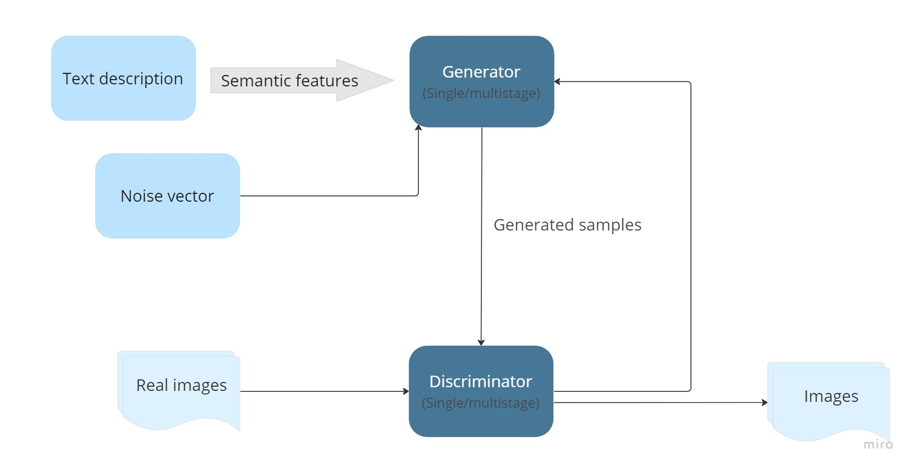
Existing architecture

Slide 9
Research Gap
Understanding the context of words
The same words may have different meaning depending upon the context in which it is used. Understanding the contextual meaning of words is still a problem in the previously used methods

Slide 10
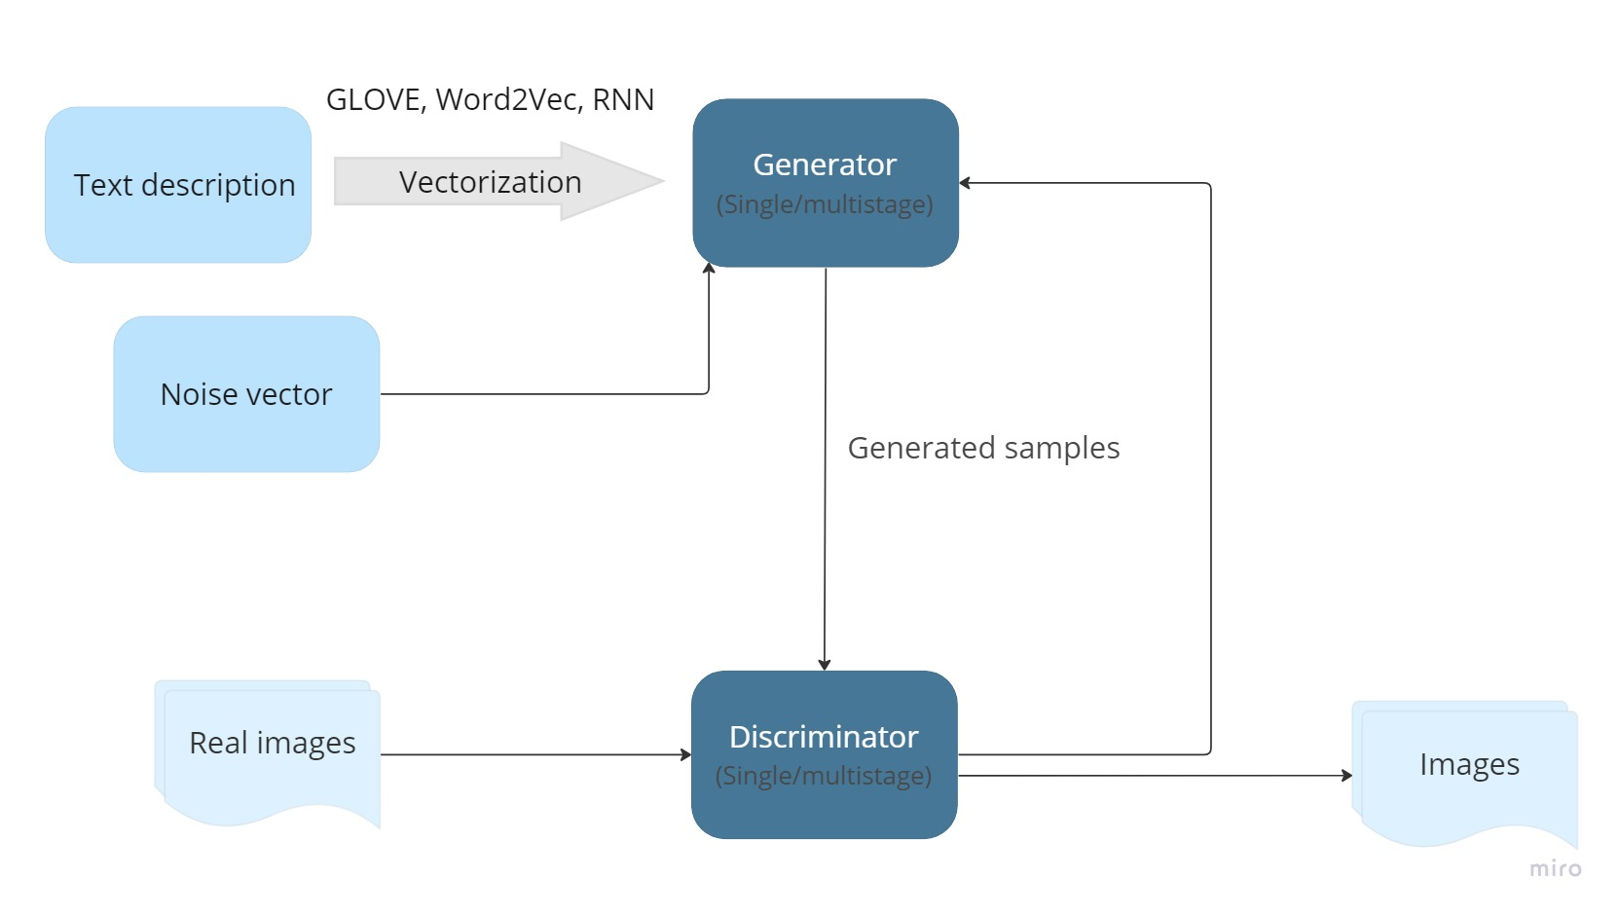
Proposed architecture

Slide 11
Its functionalities
To increase the contextual meaning by using multiple vectorization methodologies and NLP techniques

Slide 12
References
Text to Image Translation using Generative Adversarial Networks - A. Viswanathan
Text to Image Synthesis With Bidirectional Generative Adversarial Network - Z. Wang
Text to Photo-Realistic Image Synthesis with Stacked Generative Adversarial Networks - H. Zhang
Joint Embedding based Text-to-Image Synthesis - M. Wang
Text-to-Image Synthesis with a HierarchicallyNested Adversarial Network - Z. Zhang, Y. Xie
Text to Image Synthesis with Drawing Generative Adversarial Networks - Z. Zhang, J. Zhou
StackGAN++: Realistic Image Synthesis with Stacked Generative Adversarial Networks - H. Zhang et al
"Modality Disentangled Discriminator for Textto-Image Synthesis - F. Feng, T. Niu
ObjectDriven Text-To-Image Synthesis via Adversarial Training - W. Li et al
"Cross-Modal Semantic Matching Generative Adversarial Networks for Text-toImage Synthesis - H. Tan
DeepText: A new approach for text proposal generation and text detection in natural images - Zhuoyao
Text To Image Synthesis With Erudite Generative Adversarial Networks - Zhiqiang
Deep Learning for Imageto-Text Generation: A Technical Overview - Xiaodong
Joint Image-Text Hashing for Fast Large-Scale CrossMedia Retrieval - Baochang Zhang
Direct Speech Translation -to-Image - Yue Wang
Text to Image Synthesis for Improved Image Captioning - MD. ZAKIR HOSSAIN
Generating Images From Spoken Descriptions - Xinsheng Wang
Inferring Semantic Layout for Hierarchical Text-toImage Synthesis - Seunghoon Hong
Text-Guided Diverse Face Image Generation and Manipulation - Weihao Xia
Rich Feature Generation for Text-to-Image Synthesis from Prior Knowledge - Jun Cheng
G

Slide 13
Remote sensing image captioning via Variational Autoencoder and Reinforcement Learning - XiangqingShenab,BingLiuabcYong,ZhouabJiaqi,ZhaoabMingmingLiu
Autoencoders and Conditional Generative Adversarial Networks - Haileleol Tibebu, Aadil Malik, Varuna De Silva
Image Generation using Variational Autoencoders - - Purnima Sai Koumudi Panguluri, Kishore Kumar Kamarajugadda
Text to Image Synthesis Using Generative Adversarial Networks - - Cristian Bodnar Supervisor: Dr Jon Shapiro University of Manchester School of Computer Science
Adversarially Regularized Autoencoders - Jake (Junbo) Zhao * 1 2 Yoon Kim * 3 Kelly Zhang 1 Alexander M. Rush 3 Yann LeCun 1 2
Text to Image using Deep Learning - Akanksha Singh, Sonam Anekar, Ritika Shenoy, Sainath Patil
ControlVAE: Controllable Variational Autoencode - Huajie Shao 1 Shuochao Yao 1 Dachun Sun 1 Aston Zhang 2 Shengzhong Liu 1 Dongxin Liu 1 Jun Wang 3 Tarek Abdelzaher
Generative Adversarial Text to Image Synthesis - Scott Reed, Zeynep Akata, Xinchen Yan, Lajanugen Logeswaran REEDSCOT1 , AKATA2 , XCYAN1 , LLAJAN1 Bernt Schiele, Honglak Lee
Semi-Amortized Variational Autoencoders - Yoon Kim 1 Sam Wiseman 1 Andrew C. Miller 1 David Sontag 2 Alexander M. Rush 1
Text-to-Image Generation Using Deep Learning - Sadia Ramzan 1,Muhammad Munwar Iqbal 1 and Tehmina Kalsum

